Slide 1
AVL Tree
By
Prof. A. H. Hingmire

Slide 2
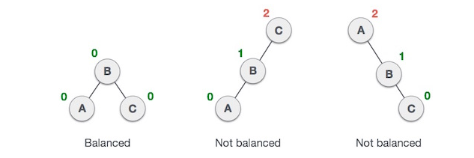
Named after their inventor Adelson, Velski & Landis.
AVL trees are height balancing binary search tree.
AVL tree checks the height of the left and the right sub-trees and assures that the difference is not more than 1.
This difference is called the Balance Factor.

Slide 3
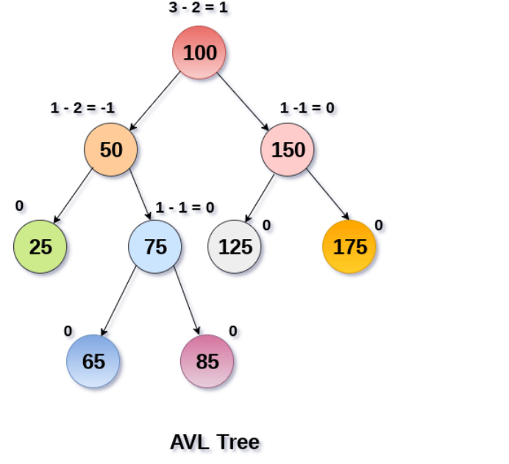

Slide 4
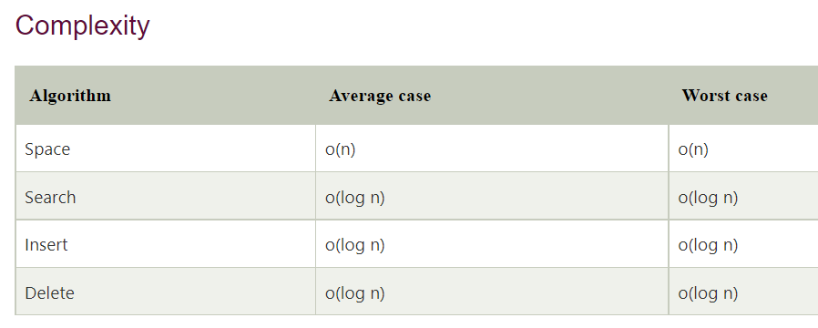
AVL Tree

Slide 5
AVL Rotations
To balance itself, an AVL tree may perform the following four kinds of rotations −
Left rotation
Right rotation
Left-Right rotation
Right-Left rotation

Slide 6
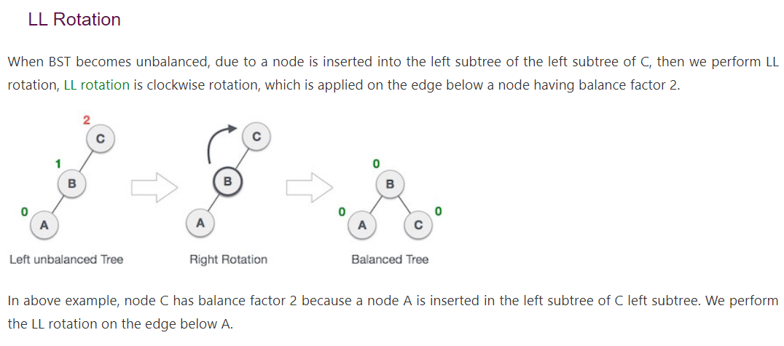
Rotation Types (1)

Slide 7
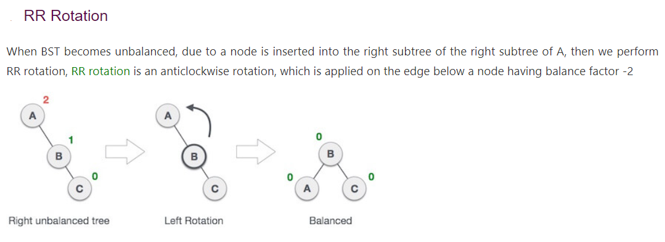
Rotation Types (2)

Slide 8
Rotation Types (3)
LR Rotation
Double rotations are bit tougher than single rotation which has already explained above. LR rotation = RR rotation + LL rotation, i.e., first RR rotation is performed on subtree and then LL rotation is performed on full tree, by full tree we mean the first node from the path of inserted node whose balance factor is other than -1, 0, or 1.

Slide 9
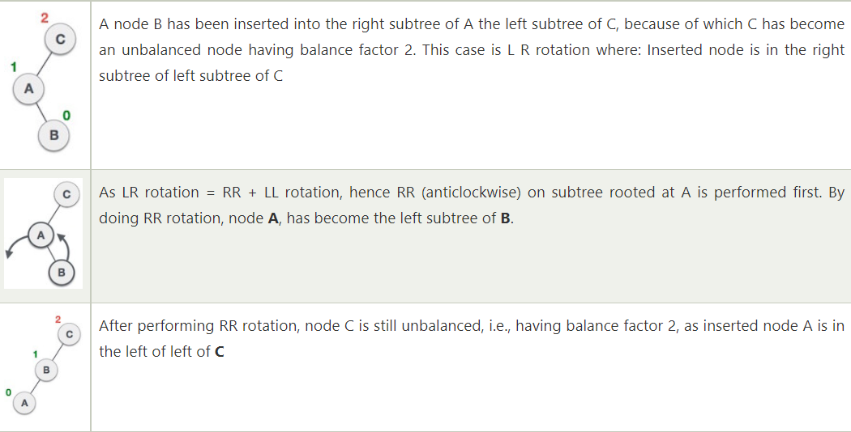
Rotation Types (3)

Slide 10
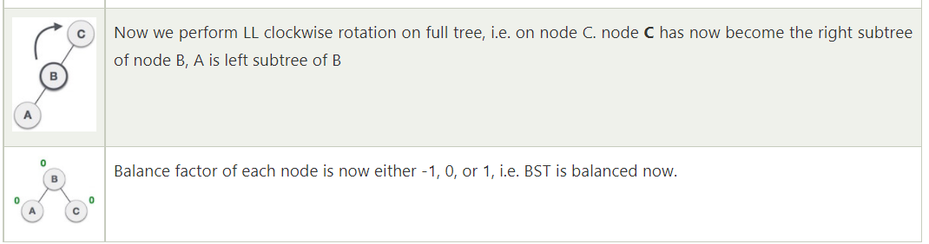
Rotation Types (3)

Slide 11
Rotation Types (4)
LR: Y is inserted in the right subtree of the left subtree of A
RL Rotation
As already discussed, that double rotations are bit tougher than single rotation which has already explained above. R L rotation = LL rotation + RR rotation, i.e., first LL rotation is performed on subtree and then RR rotation is performed on full tree, by full tree we mean the first node from the path of inserted node whose balance factor is other than -1, 0, or 1.

Slide 12
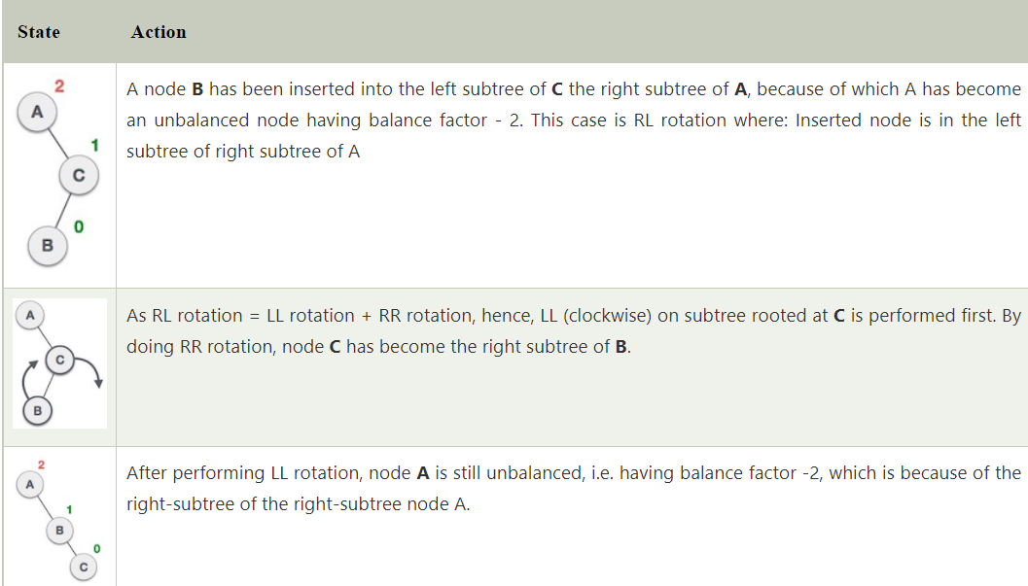
Rotation Types (4)
LR: Y is inserted in the right subtree of the left subtree of A

Slide 13
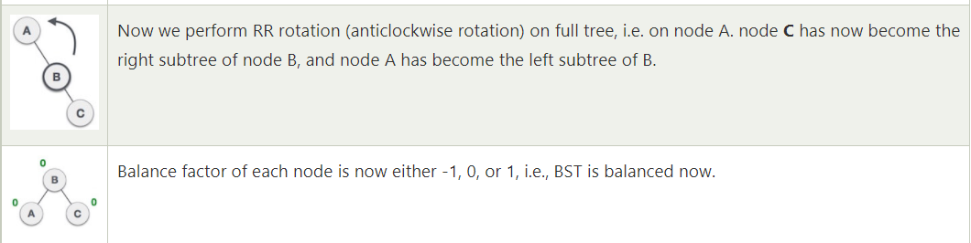
Rotation Types (4)
LR: Y is inserted in the right subtree of the left subtree of A

Slide 14
Construction of an AVL Tree
Consider to insert the following numbers:
8, 9, 10, 2, 1, 5, 3, 6, 4, 7, 11, 12
BF:0
BF:-1
8
8
BF:0
Insert 8
9
Insert 9

Slide 15
Consider the nearest parent A with bf = ±2
BF:-2
8
8
BF:0
BF:-1
RR-Case
9
9
9
BF:0
BF:0
BF:0
8
10
insert in the right subtree of the right subtree of A
10
Insert 10

Slide 16
BF:1
9
BF:1
BF:0
8
10
BF:0
2
Insert 2

Slide 17
BF:2
Consider the nearest parent A with bf = ±2
9
BF:1
BF:2
BF:0
8
9
8
10
BF:0
BF:1
BF:0
LL-Case
2
10
2
2
BF:0
BF:0
BF:0
1
8
1
insert in the left subtree of the left subtree of A
Insert 1

Slide 18
Consider the nearest parent A with bf = ±2
BF:0
BF:2
9
8
9
BF:0
BF:-1
BF:-1
BF:0
LR
2
9
2
10
BF:0
BF:0
BF:0
BF:0
BF:1
1
5
10
1
8
8
insert in the right subtree of the left subtree of A
BF:0
5
Insert 5

Slide 19
BF:1
BF:1
8
8
BF:-1
BF:-1
BF:-1
-BF:1
2
9
2
9
BF:0
BF:1
BF:0
BF:0
BF:0
BF:0
1
5
10
1
5
10
BF:0
BF:0
BF:0
3
3
6
Insert 6
Insert 3

Slide 20
Consider the nearest parent A with bf = ±2
BF:1
BF:2
8
8
BF:-2
BF:-1
BF:0
BF:-1
3
9
2
2
9
BF:0
BF:0
BF:1
BF:0
BF:0
BF:1
RL
1
5
10
2
5
10
BF:0
BF:0
BF:0
BF:-1
BF:0
1
3
4
6
3
6
insert in the left subtree of the right subtree of A
BF:0
4
Insert 4

Slide 21
BF:2
BF:0
8
5
8
BF:-1
BF:-1
BF:1
BF:0
3
9
3
8
LR
BF:1
BF:-1
BF:0
BF:1
BF:0
BF:-1
BF:-1
2
5
5
10
2
4
6
9
BF:0
BF:0
BF:0
BF:-1
BF:0
BF:0
1
1
7
10
4
6
BF:0
Insert 7
7

Slide 22
BF:-1
5
BF:1
BF:-1
3
8
BF:1
BF:0
BF:-1
BF:-2
9
RR-case
2
4
6
9
BF:0
BF:0
BF:-1
1
7
10
10
BF:0
BF:0
11
5
Insert 11
BF:1
BF:0
3
8
BF:1
BF:0
BF:-1
BF:0
2
4
6
10
BF:0
BF:0
BF:0
BF:0
1
7
9
11

Slide 23
BF:-1
5
BF:1
BF:-1
3
8
BF:1
BF:0
BF:-1
BF:-1
2
6
10
4
BF:0
BF:0
BF:0
BF:-1
1
7
9
11
Insert 12
BF:0
12

